Slide 1

Nescafe Gold Blend
DRD Template
February 2022
Nescafe Dolce Gusto
MMX Topline Results – Capsule Sales
June 2022

Slide 2
Project Scope
Characteristics
Details
Target Brand
Nestle Dolce Gusto (NDG)
Granularity
National Level
Market Breakdown
National - Total Japan
Regions - NA
Time Period
FY 2019 - 52 WE 12/30/2019
FY 2020 – 52 WE 12/28/2020
FY 2021 – 52 WE 12/27/2021
Total Analysis: 156 Weeks
[ 12/31/2018 – 12/27/2021]
Dependent Variable
3.Capsule sales
Independent Variables
Cumulative Machine Counts, Website, Tweet Counts, Aided Awareness, Temperature, TV, Digital Media, Trade etc.
Reporting Results
Model Results, Due-to, ROI and Simulation

Slide 3
Model Inputs:
Own Ad
Non-Ad
Category | Variables Used | Data Definition
Static | DV360 | Impressions
Static | FB | Impressions
Static | GDN | Impressions
Static | LINE | Impressions
Static | Others | Impressions
Static | Smart news | Impressions
Static | Teads | Impressions
Static | Twitter | Impressions
Static | Yahoo SPBP | Impressions
Static | YDN | Impressions
Video | FB | Impressions
Video | LINE | Impressions
Video | Premium View | Impressions
Video | Teads | Impressions
Video | True view | Impressions
Video | Tver | Impressions
Video | TW | Impressions
Others | GAW | Impressions
Others | YSS | Impressions
Others | AFF | Spend
Others | PSD | Spend
TV | TV Spot | GRPs
TV | TV Time | GRPs
Variables Used | Data Definition
Tweets | Count of Tweets
Purchase Intent | Purchase Intent in %
Instore ID POS | Instore event ID POS
Instore Sales Demo | Instore event sales
Instore Rental Demo | Instore Rental Demo
Website PV | Top Page Views
Awareness | Awareness for NDG in %
Cumulative Machine Counts | Cumulative Number of Applicants to Date
Temperature | Degrees Celsius
Holiday
New Year
Mobility
FY 2019 – 52 weeks ending Dec 2019
FY 2020 – 52 weeks ending Dec 2020
FY 2021 – 52 weeks ending Dec 2021

Slide 4
SECTION 01
KPI

Slide 5
Model Fit - KPI – Machine Rentals
 | R-Square | MAPE
Model Statistics | 85.7% | 9.4%
Actual Vs. Predicted
Machine Sales
Source: Analytic Edge Models
Note:

Slide 6
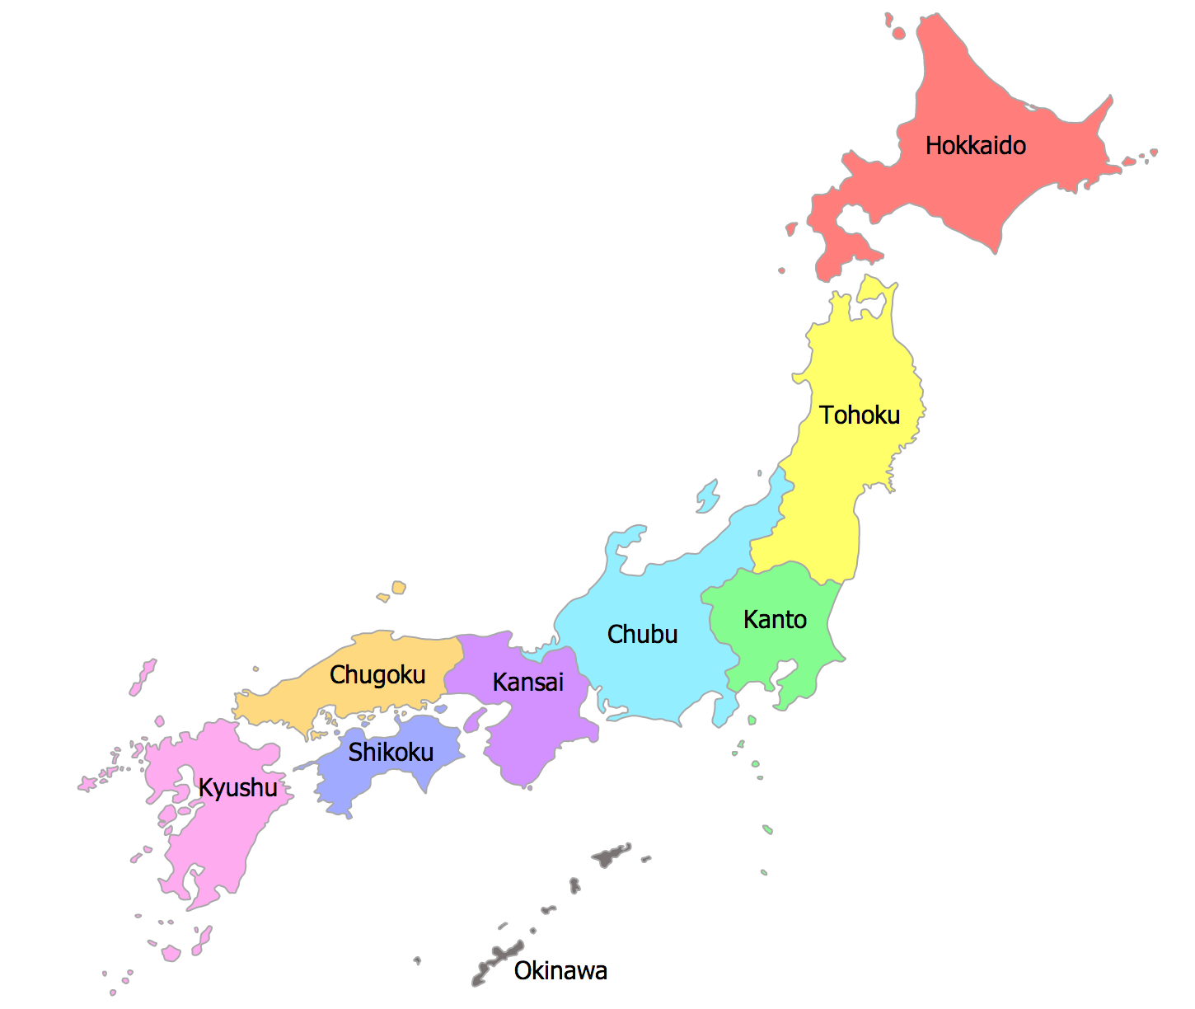
NDG Sales increased in 2021 by 16%
 | 2019 | % Change 2020 vs 2019 | 2020 | % Change 2021 vs 2020 | 2021 | Total
Capsule Sales (MM) | 227 | -9.0% | 207 | -8.5% | 189 | 624
FY 2019 – 52 weeks ending Dec 2019
FY 2020 – 52 weeks ending Dec 2020
FY 2021 – 52 weeks ending Dec 2021

Slide 7
Business Questions
To understand the Media and Non-Media impact on capsule sales
1
To understand which Ad drivers to focus on to increase the capsule sales
2
To understand how the Ad drivers spends affect the capsule sales increase
3
To understand which digital media, contribute to increase the capsule sales
4
To understand the re-allocation of the investment across the Ad drivers to increase the capsule sales.
5

Slide 8
SECTION 02
Due-to & Contribution

Slide 9
NDG rentals decreased in 2021 by around 8.5%
9.0%
8.5%
227.4
207.0
189.3
FY 2019 – 52 weeks ending Dec 2019
FY 2020 – 52 weeks ending Dec 2020
FY 2021 – 52 weeks ending Dec 2021
Note-
Source : Analytic Edge Models

Slide 10
Total Due-To
2020 vs 2019
2021 vs 2020
Note-
Source : Analytic Edge Models

Slide 11
Due-To : Own Ad
2020 vs 2019
2021 vs 2020
CHANGE IN SUPPORT
CHANGE IN SUPPORT
56%
-25%
--
++
-33%
-80%
-8%
-75%
-77%
-41%
--
++
Note-
Source : Analytic Edge Models

Slide 12
Support Summary : Own Ad
Support | Metric | 2019 | 2020 | 2021
Static | Impressions (in Mio.) | 245.8 | 383.3 | 272.5
Video | Impressions (in Mio.) | 5.2 | - | 103.4
YSS | Impressions (in Mio.) | 13.7 | 9.3 | 1.8
GAW | Impressions (in Mio.) | 8.0 | 7.4 | 1.8
AFF | Spends (in Mio. JPY) | 105.8 | 23.8 | 14.1
TV | GRPs (in 000’s) |  |  | 1.3
56%
-29%
-33%
-80%
-8%
-75%
-77%
-41%
Note-
Source : Analytic Edge Models

Slide 13
Due-To : Non-Ad
2020 vs 2019
2021 vs 2020
CHANGE IN SUPPORT
CHANGE IN SUPPORT
-38%
117%
1.0 pt.
-0.4 pt.
-2,700 pt.
-1,596 pt.
-1,987 pt.
2,657 pt.
-9,491 pt.
7,685 pt.
-18%
-4%
0.3 C
0.1 C
3.3 mio. Pt.
2.1 mio. Pt.
--
--
--
--
--
--
--
--
Note-
Source : Analytic Edge Models

Slide 14
Support Summary : Non- Ad
Support | 2019 | 2020 | 2021
Tweets | 148,275 | 91,853 | 199,431
Purchase Intent | 11.7 | 12.8 | 12.4
Instore ID POS | 4,296 | 1,596 | 0
Instore Sales Demo | 2,661 | 674 | 3,331
Instore Rental Demo | 14,537 | 5,046 | 12,731
Website Page views | 4,606,070 | 3,795,833 | 3,628,086
Temperature | 11.2 | 16.6 | 16.7
Cumulative Machine Counts(in mio.) | 38 | 41 | 44
Holiday | - | - | -
New Year | - | - | -
Covid-19 | - | - | -
-38%
++
9%
-3%
-63%
--
-75%
++
-65%
++
-18%
-4%
48%
1%
9%
5%
Note-
Source : Analytic Edge Models

Slide 15
Own Ad- Volume by year
12.2%
11.4%
10.1
11.4
12.7
Spends
(Mio. JPY)
308
-52.7%
146
++
414
Note-
Source : Analytic Edge Models

Slide 16
Own Ad Volume by year
% Contribution to Sales
Incremental Volume(MM)
Note-
Source : Analytic Edge Models

Slide 17
Own Ad : Static Volume by year
% Contribution to Sales
Incremental Volume(MM)
Note-
Source : Analytic Edge Models

Slide 18
Own Ad : Video Volume by year
% Contribution to Sales
Incremental Volume(MM)
Note-
Source : Analytic Edge Models

Slide 19
Non-Ad Volume by year
% Contribution to Sales
Incremental Volume(MM)
Note-
Source : Analytic Edge Models

Slide 20
SECTION 03
Efficiency

Slide 21
Own Ad : Efficiency
Efficiency – Own Ad
 | Spends (mio. JPY) | CPM | Spends (mio. JPY) | CPM | Spends (mio. JPY) | CPM | Spends (mio. JPY) | CPM | Spends (mio. JPY) | CPM | Spends (mio. JPY) | CPM
2019 | 90 | 365 | 9 | 1,800 | 35 | 2,553 | 68 | 8,569 | 106 | - | - | -
2020 | 49 | 128 | - | - | 22 | 2,396 | 51 | 6,955 | 24 | - | - | -
2021 | 65 | 238 | 78 | 754 | 9 | 4,746 | 21 | 11,424 | 14 | - | 228 | 171,922
Note-
Source : Analytic Edge Models
Efficiency [ Incr sale per 1000 JAP YEN]

Slide 22
Own Ad : Static - Efficiency
Efficiency – Own Ad
 | DV 360 |  | FB |  | GDN |  | LINE |  | Others |  | Smartnews |  | Teads |  | Twitter |  | Yahoo |  | YDN
Spends (mio. JPY) | Spends | CPM | Spends | CPM | Spends | CPM | Spends | CPM | Spends | CPM | Spends | CPM | Spends | CPM | Spends | CPM | Spends | CPM | Spends | CPM
2019 | 6.5 | 122 | 7.1 | 1,664 | 25.9 | 186 |  |  | 3.6 | 480 |  |  | 18.7 | 1,395 | 3.0 | 228 | 25.0 | 1,674
2020 | 1.3 | 783 | 16.5 | 436 | 12.2 | 128 | 7.5 | 203 | 0.9 | 246 | 5.0 | 27 |  |  |  |  |  |  | 5.8 | 255
2021 |  |  | 31.1 | 962 | 9.4 | 113 | 7.8 | 237 | 3.4 | 324 |  |  | 0.6 | 1,231 | 4.7 | 298 |  |  | 7.9 | 81
Note-
Source : Analytic Edge Models
Efficiency [ Incr sale per 1000 JAP YEN]

Slide 23
Own Ad : Video- Efficiency
Efficiency – Own Ad
 | Spends (mio. JPY) | CPM | Spends (mio. JPY) | CPM | Spends (mio. JPY) | CPM | Spends (mio. JPY) | CPM | Spends (mio. JPY) | CPM | Spends (mio. JPY) | CPM | Spends (mio. JPY) | CPM | Spends (mio. JPY) | CPM
2019 | 3 | 1,919 |  |  |  |  |  |  | 6 | 1,749
2021 | 17 | 447 | 1 | 200 | 6 | 4,502 | 3 | 2,075 | 15 | 623 | 31 | 2,225 | 3 | 239 | 1 | 331
Note-
Source : Analytic Edge Models
Efficiency [ Incr sale per 1000 JAP YEN]

Slide 24
Efficiency and contribution by Own tactics –2019
Efficiency =
Incremental capsule sales
Spends of 1,000 JPY
Note-
Source : Analytic Edge Models

Slide 25
Efficiency and contribution by Own tactics –2020
Efficiency =
Incremental capsule sales
Spends of 1,000 JPY
Contribution (Incremental capsules(MM))
Note-
Source : Analytic Edge Models

Slide 26
Efficiency and contribution by Own tactics –2021
Efficiency =
Incremental capsule sales
Spends of 1,000 JPY
Note-
Source : Analytic Edge Models

Slide 27
Efficiency and contribution by Own tactics(Static) –2019
Efficiency =
Incremental capsule sales
Spends of 1,000 JPY
Note-
Source : Analytic Edge Models

Slide 28
Efficiency and contribution by Own tactics(Static) –2020
Efficiency =
Incremental capsule sales
Spends of 1,000 JPY
Note-
Source : Analytic Edge Models

Slide 29
Efficiency and contribution by Own tactics(Static) –2021
Efficiency =
Incremental capsule sales
Spends of 1,000 JPY
Note-
Source : Analytic Edge Models

Slide 30
Efficiency and contribution by Own tactics(Video) –2021
Efficiency =
Incremental capsule sales
Spends of 1,000 JPY
Note-
Source : Analytic Edge Models

Slide 31
SECTION 04
Effectiveness

Slide 32
Own Ad : Effectiveness
Effectiveness – Own Ad
 | Support (mio) | Incr. Sales | Support (mio) | Incr. Sales | Support (mio) | Incr. Sales | Support (mio) | Incr. Sales | Support (000’) | Incr. Sales
2019 | 246 | 6.7 | 5 | 0.1 | 14 | 1.1 | 8 | 0.3 | - | -
2020 | 384 | 9.9 | - |  | 9 | 0.7 | 7 | 0.2 | - | -
2021 | 272 | 7.9 | 103 | 2.7 | 2 | 0.1 | 2 | 0.0 | 1 | 1.8
Note-
Source : Analytic Edge Models
Effectiveness [ Incremental Sales / Support]

Slide 33
Own Ad : Static - Effectiveness
Effectiveness – Own Ad
 | DV 360 |  | FB |  | GDN |  | LINE |  | Others |  | Smartnews |  | Teads |  | Twitter |  | Yahoo |  | YDN
Support (mio.) | Support | Incr. Sales | Support | Incr. Sales | Support | Incr. Sales | Support | Incr. Sales | Support | Incr. Sales | Support | Incr. Sales | Support | Incr. Sales | Support | Incr. Sales | Support | Incr. Sales | Support | Incr. Sales
2019 | 53 | 2.5 | 4 | 0.7 | 139 | 1.3 |  |  | 7 | 0.2 |  |  | 13 | 0.5 | 13 | 0.8 | 15 | 0.7
2020 | 2 | 0.1 | 38 | 5.2 | 95 | 1.2 | 37 | 1.2 | 4 | 0.1 | 185 | 1.8 |  |  |  |  |  |  | 23 | 0.2
2021 |  |  | 32 | 4.0 | 83 | 0.6 | 33 | 0.8 | 10 | 0.4 |  |  | 1 | 0.02 | 16 | 0.8 |  |  | 97 | 1.3
Note-
Source : Analytic Edge Models
Effectiveness [ Incremental Sales / Support]

Slide 34
Own Ad : Video- Effectiveness
Effectiveness – Own Ad
 | Support (mio) | Incr. Sales | Support (mio) | Incr. Sales | Support (mio) | Incr. Sales | Support (mio) | Incr. Sales | Support (mio) | Incr. Sales | Support (mio) | Incr. Sales | Support (mio) | Incr. Sales | Support (mio) | Incr. Sales
2019 | 1.6 | 0.04 | - | - | - | - | - | - | 3.7 | 0.1 | - | - | - | - | - | -
2021 | 38.2 | 0.8 | 7.1 | 0.03 | 1.3 | 0.1 | 1.4 | 0.04 | 24.4 | 0.6 | 13.9 | 0.9 | 12.6 | 0.2 | 4.5 | 0.02
Note-
Source : Analytic Edge Models
Effectiveness [ Incremental Sales / Support]

Slide 36
Appendix

